Slide 1
Merge Sorted Array
Eunice Njeri
Charity Kimani
Lesley Bonyo

Slide 2
Problem
You are given two integer arrays nums1 and nums2, sorted in non-decreasing order, and two integers m and n, representing the number of elements in nums1 and nums2 respectively.
Merge nums1 and nums2 into a single array sorted in non-decreasing order.
The final sorted array should not be returned by the function, but instead be stored inside the array nums1. To accommodate this, nums1 has a length of m + n, where the first m elements denote the elements that should be merged, and the last n elements are set to 0 and should be ignored. nums2 has a length of n.

Slide 3
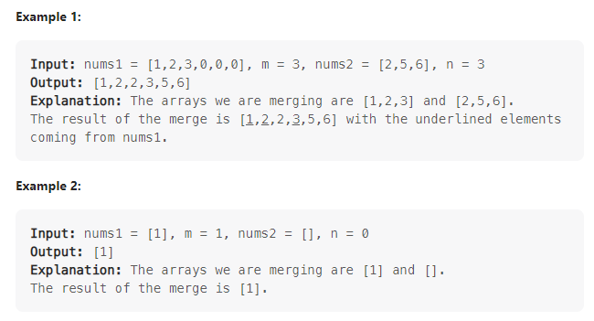
Problem

Slide 4
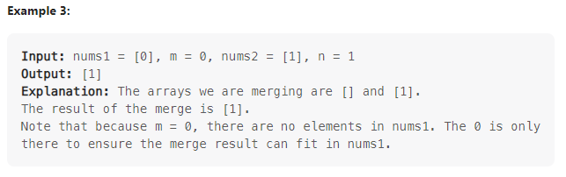
Problem

Slide 5
Solution
1. Compare the elements of the two sorted arrays – starting from the greatest in each array
2. Place the greatest of the two at the end of the first array
Repeat
Complexity O(m + n)

Slide 6
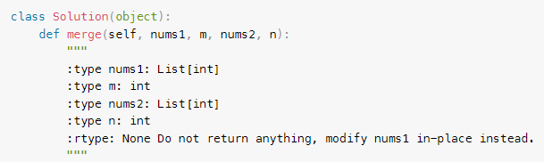
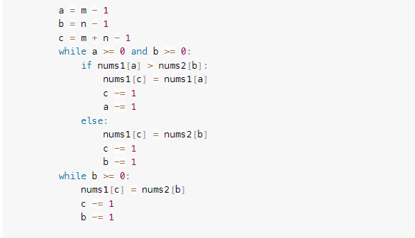
Code

Slide 7
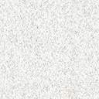
The End

